Slide 1
Item Writer Workshop
January 2nd, 2018
Stephanie Tedford- 3rd grade (all subjects)
Jessica Pickett-4th grade Math, Science, Social Studies
Samantha Dawson- 5th grade Math, Science, Social Studies
Find this power point with all the hyperlinked websites and documents by going to:
pickettandjones.weebly.com
On the far right-hand side, hover over the word MORE, and choose TEACHER RESOURCES from the drop-down menu

Slide 2
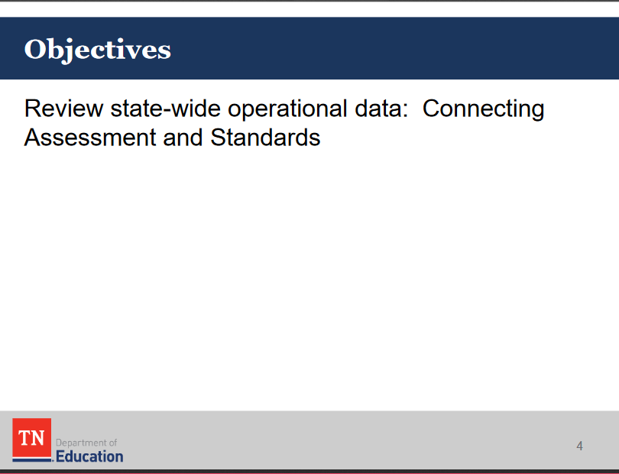
*Goals of the Math Item Writer Workshop*
…we will explore some components of this today, with a more practical approach than what was presented from the state. ☺

Slide 3
Main Goals for Today:
Explore the Instructional Focus Document
  Where to find it
  How to read it
  How to use it for linear planning
  How to use it when teaching for conceptual understanding vs. procedural understanding
Provide websites of TN Ready style assessment questions

Slide 4
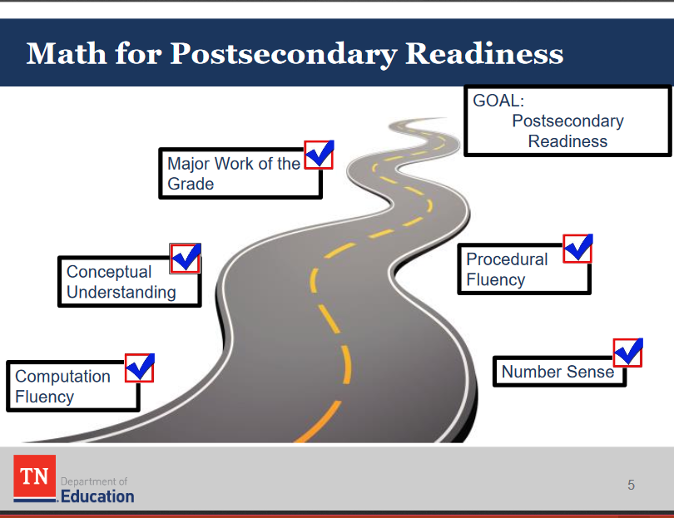

Slide 5
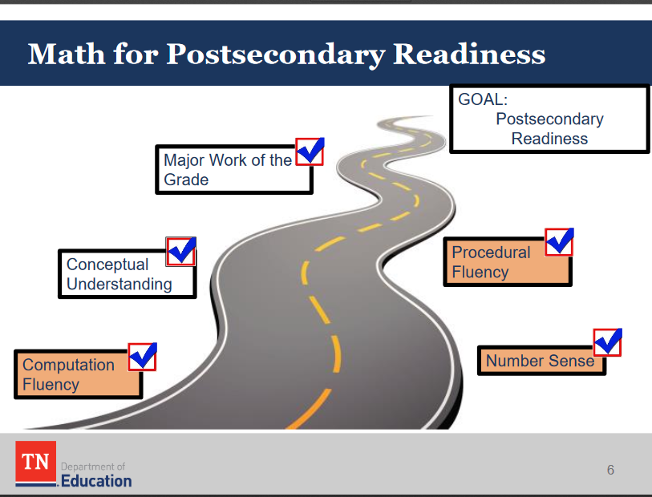
Notice the highlighted components of teaching and learning- These are assessed on the non-calculator portion of TN Ready.

Slide 6
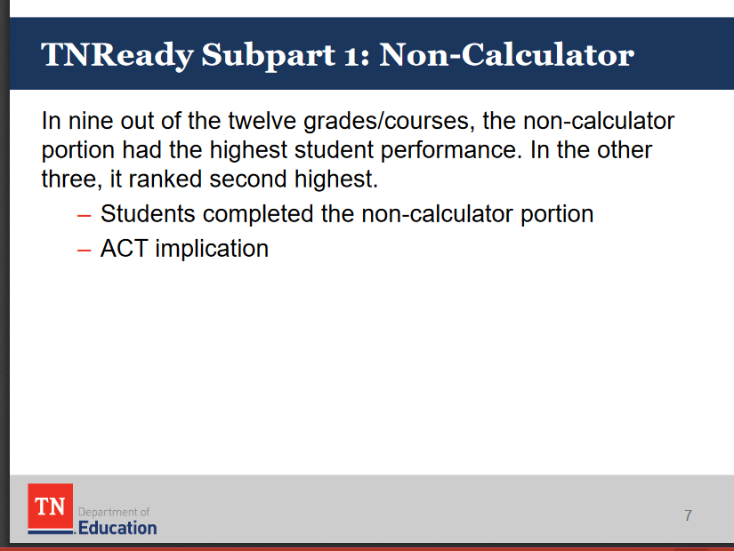
This is statewide based on their results. Anything interesting or enlightening about this?

Slide 7
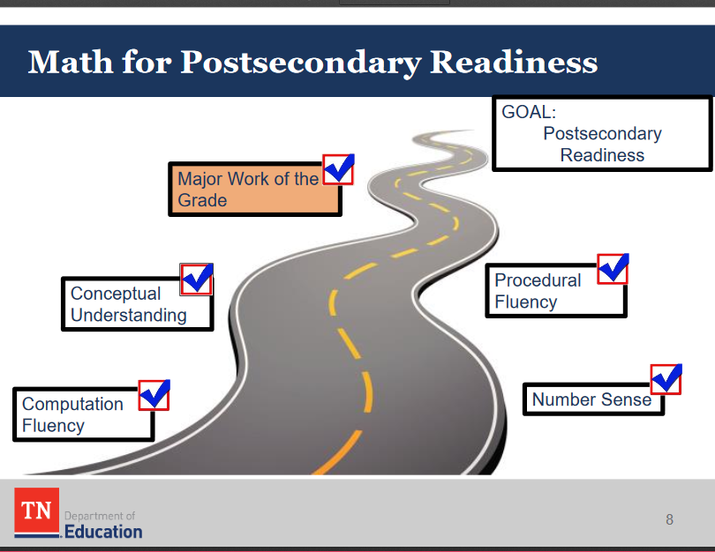
Notice the highlighted components of teaching and learning.

Slide 8
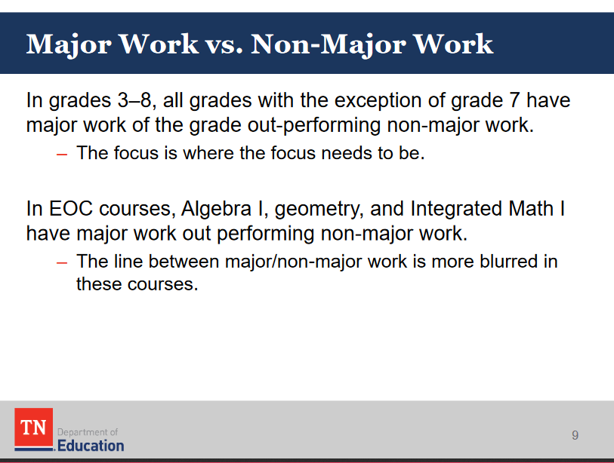
The state says.. KUDOS!

Slide 9
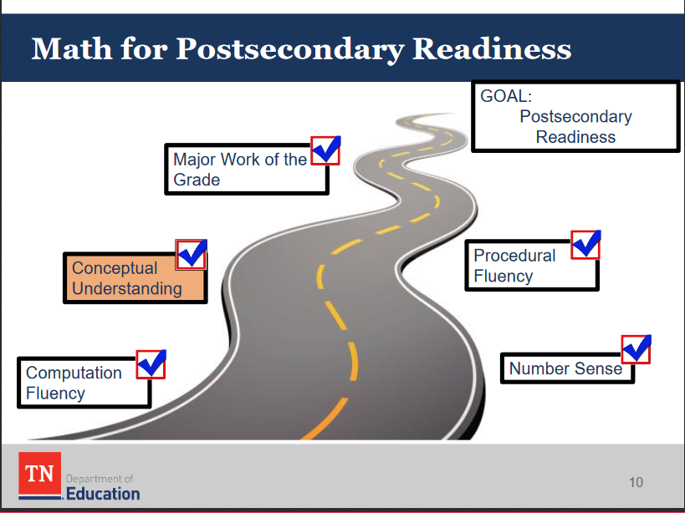
Notice the highlighted components of teaching and learning.

Slide 10
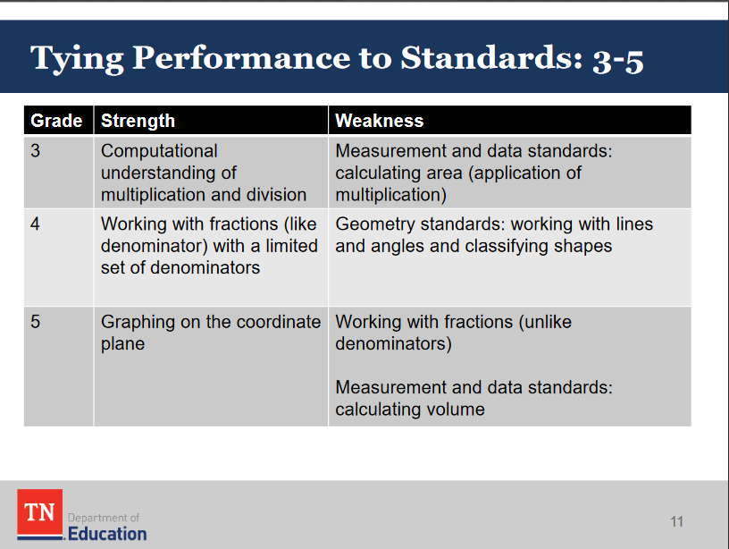
Do you notice any similarities and differences in the
strengths and weaknesses?

Slide 11
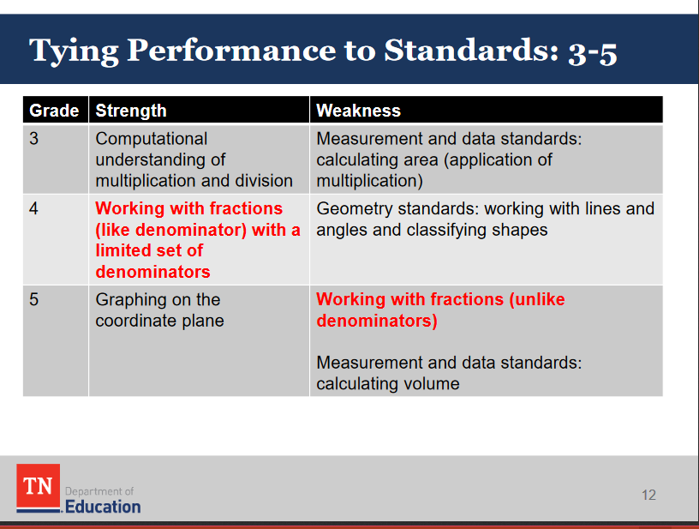
This falls under the category of Conceptual Understanding. The state says there shouldn’t be a strength one year in something but then the next year, a weakness in something that it builds upon. This is the debate of procedural vs. conceptual teaching.

Slide 12
Instructional Focus Document
*Only created for Numbers and Operations- Fractions standards as of right now. The state expects to have the other standards done over the next couple of YEARS. ☺

Slide 13
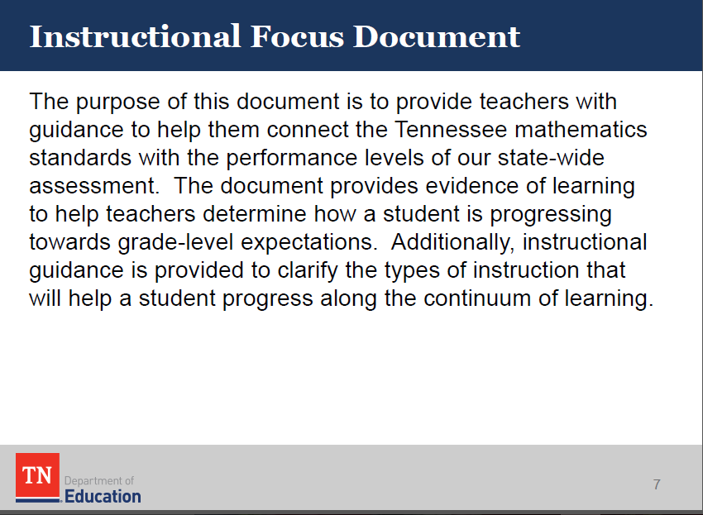
http://www.livebinders.com/play/play?id=2244559#anchor
**Click on Item Writer Workshops, then Math Standards Support, then choose grade level

Slide 14
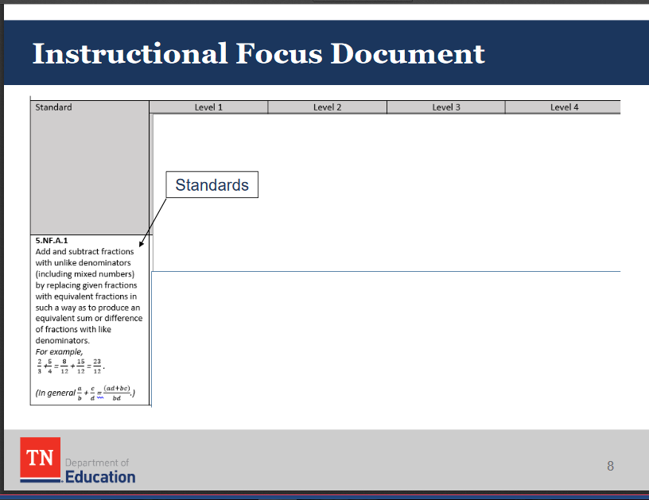
Standards are listed along the sides of the document.

Slide 15
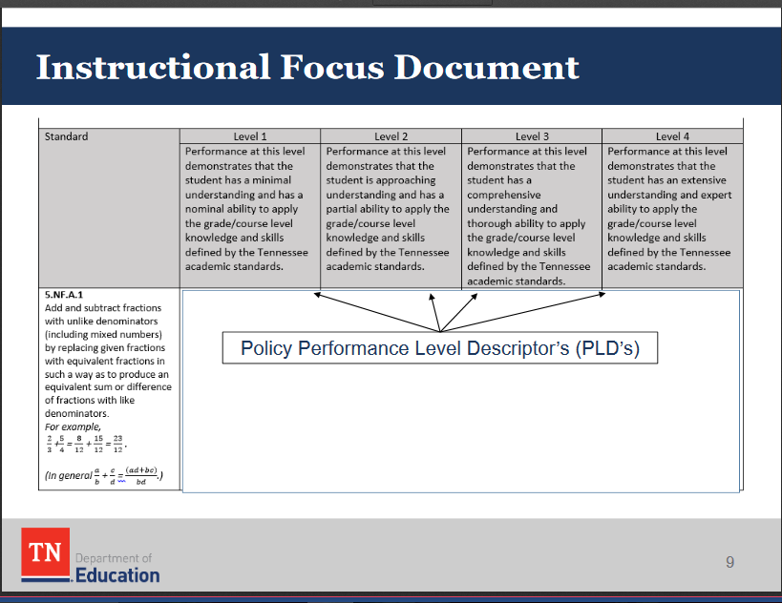
These coordinate with the 4 levels of proficiency on TN Ready.
1- Below
2- Approaching
3- On Track
4- Mastered

Slide 16
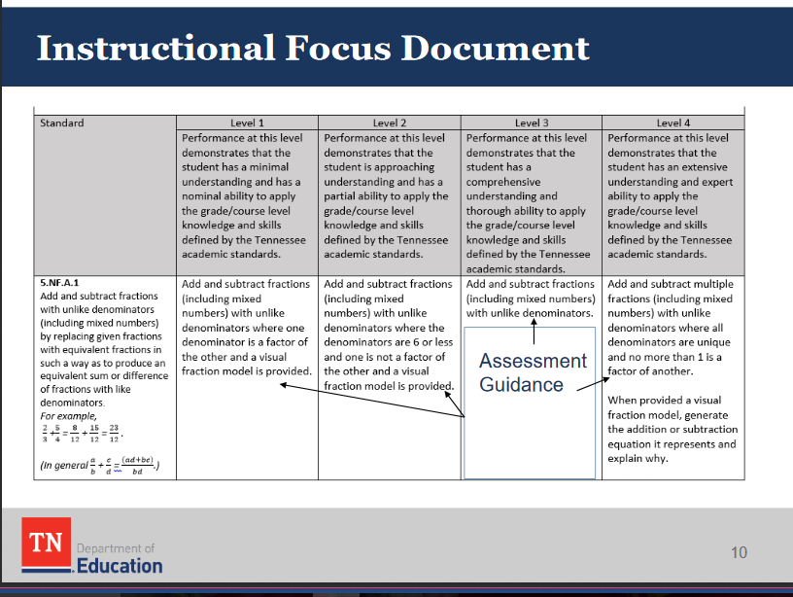
These tell you what the student should be able to do at each level of proficiency. You want to make sure your level of instruction and classroom assessments are at level 3 and 4. This will help you identify if your teaching is rigorous enough.

Slide 17
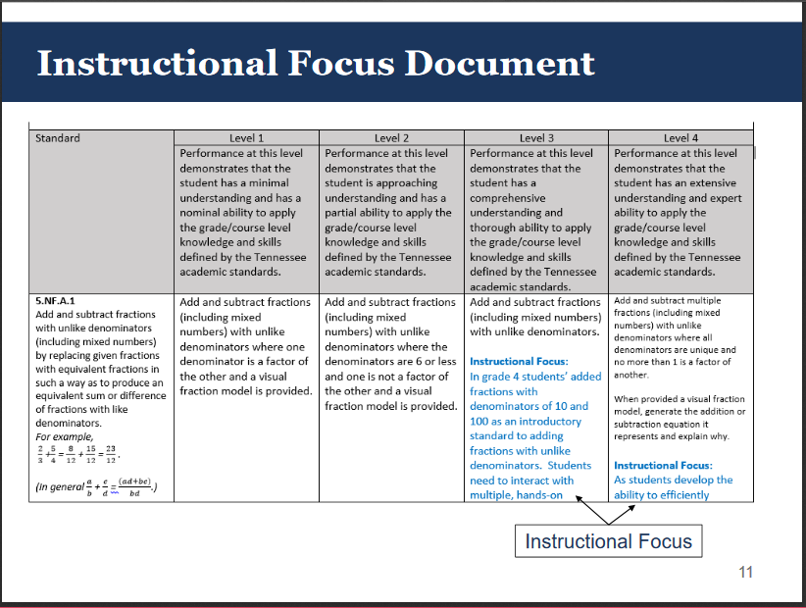
At levels 3 and 4, there is an “Instructional Focus” which breaks the standard down further and gives you more explicit information on what needs to be taught in order for students to meet those proficiency levels. Again, this encourages and double checks the rigor of our teaching. This also helps to give teachers background information for what knowledge students have to build upon from the previous year.

Slide 18
Conceptual teaching vs. Procedural teaching
Use the instructional document to help in linear planning by building on what was taught the prior year
  Multiplication and division in 3rd, 4th, and 5th grade
  Benchmark fractions in 3rd, 4th, and 5th grade when used to compare
Use the instructional document to make sure a trick or tip isn’t being taught that will end up hindering the conceptual understanding for future standards

Slide 19
Assessments
**Question Types and Time Limits**

Slide 20
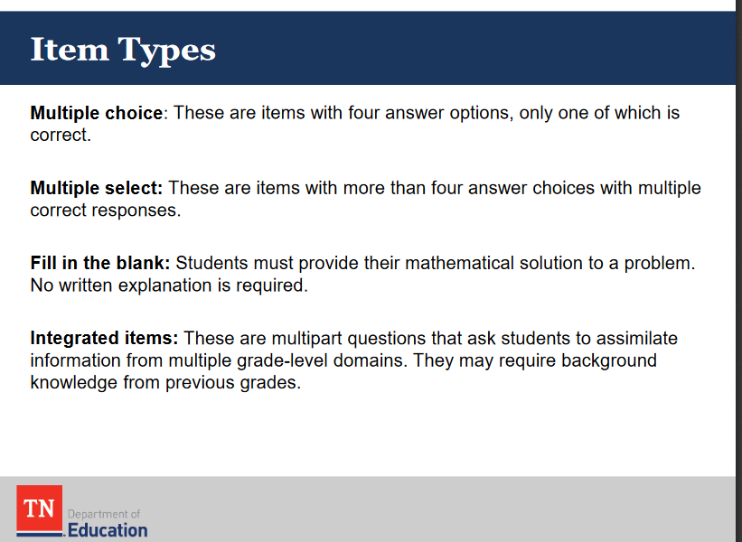
Multiple Select- 5 Item Choices- They WILL be told the number of correct!!

Slide 21
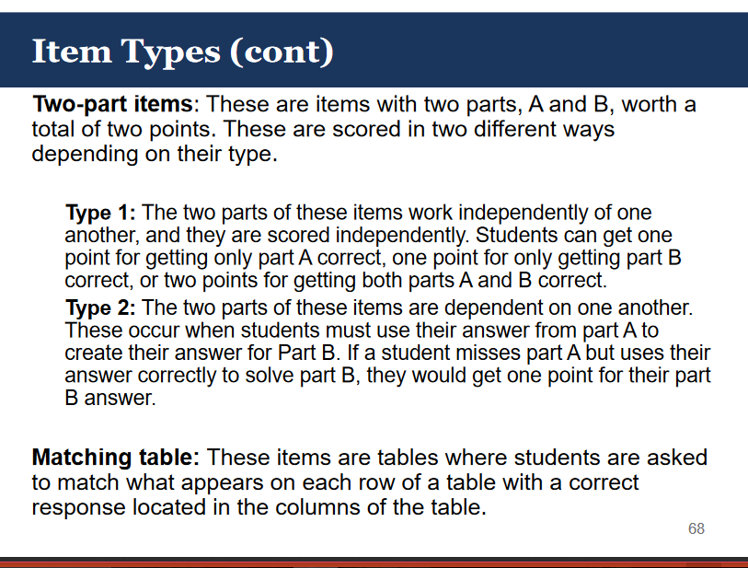

Slide 22
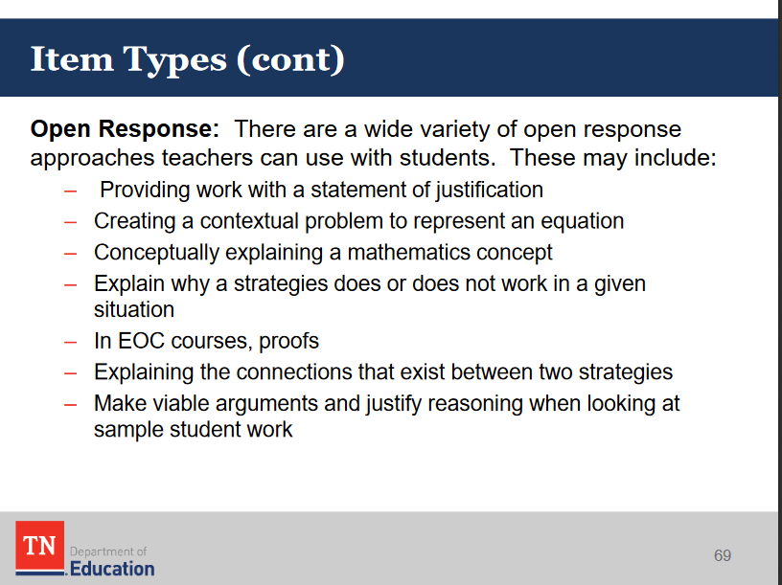

Slide 23
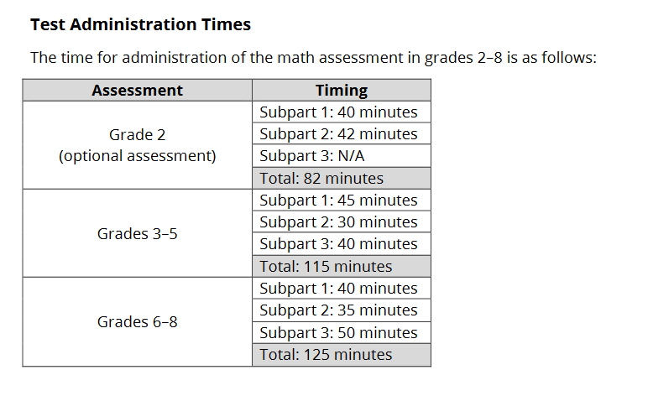

Slide 24
Assessment Support
**Websites and Tools**

Slide 25
Assessment Support Websites
EdTools
  Put in username and password and then click on resources
Nextera
  This is the Classroom Assessment builder which is supposed to be available for all grades January 8th.
MS Assessment (created by Questar)
NY Assessment (created by Questar)

Slide 26
Questions

Slide 27
Session 4 ONLY survey
Please use your phone or i-pad to complete this survey
Go to: Socrative.com
  Click on “Student Login”
  Enter Room Name: PB3BSGCZS and click “Join”
  Enter your name (real or made up)
  Take Survey
Wait for announcement regarding door prizes. ☺

